Slide 1
Going Deeper with Normalisation, Encoding and Segmentation
AI and Data Science
Lecture 2
By
Muhammad Sanan Qureshi

Slide 2
Outline
Data Normalization
Encoding
Segmentation

Slide 3
First, let’s open Google Collab

Slide 4
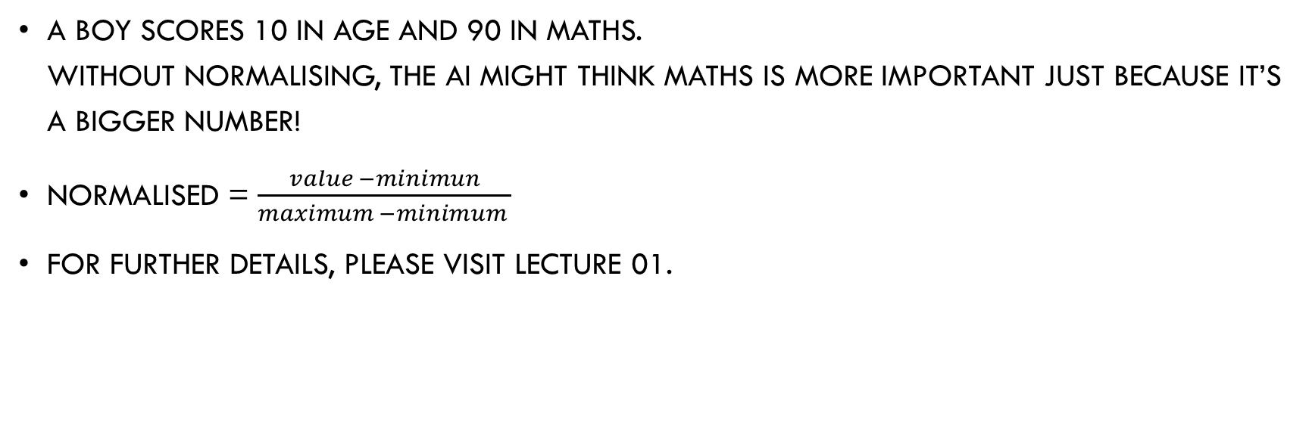
Normalisation
A boy scores 10 in Age and 90 in Maths. Without normalising, the AI might think Maths is more important just because it’s a bigger number!
Normalised = $\frac{value −minimun}{maximum −minimum }$
For further details, please visit lecture 01.

Slide 5
Encoding – I
Encoding means converting text data into numbers so machines can understand.
Example: Gender column — "Boy", "Girl“
Gender | Code
Boy | 0
Girl | 1

Slide 6
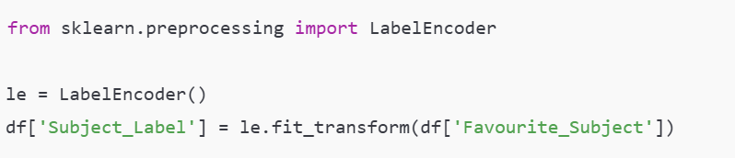
Encoding – II
Subject | Label
Maths | 2
Science | 3
English | 0
History | 1
Label Encoding
When categories have some order
(e.g., "Low", "Medium", "High")

Slide 7
Encoding – III
One-Hot Encoding
One-Hot Encoding makes a new column for each category. It fills 1 where the category is present and 0 for all others.
Maths | Science | English | History
1 | 0 | 0 | 0
0 | 1 | 0 | 0
0 | 0 | 1 | 0

Slide 8

Encoding – IV
When categories are not ordered.
When you don’t want the model to think one category is "greater" than another.

Slide 9
Encoding – V
from sklearn.preprocessing import LabelEncoder
This line tells Python to bring in the LabelEncoder tool from a library called scikit-learn.
le_gender = LabelEncoder()
This one will be used to convert gender ("Boy", "Girl") into numbers.
Hey Python, please make a labeller called ‘le_gender’ to label the genders.

Slide 10
Encoding – VI
df['Gender_Code'] = le_gender.fit_transform(df['Gender‘])
‘le_gender.fir_transfirm’= this learns all the categories and replaces them with numbers.
The result is stored in a new column called ‘Gender_Code’.
Gender | Gender_Code
Boy | 0
Girl | 1

Slide 11
Encoding – VII
In a same manner we will convert Subjects into numbers.
Favourite_Subject | Subject_Code
Science | 2
Maths | 1
English | 0

Slide 12
Segmentation – I
Segmentation means dividing data into groups (or segments) based on something they have in common.
We use segmentation when we want to:
Understand patterns
Compare groups
Apply different rules or models to each group

Slide 13
Segmentation – II
Let’s say we have a class of students. We can segment them based on:
This helps us answer questions like:
Are 13-year-olds scoring better in Science?
Do students who
like Maths also do well in it?
Segment Type | Examples
Age Group | 12-year-olds, 13-year-olds
Gender | Boys and Girls
Maths Score Level | Low, Medium, High
Favourite Subject | Science, English, Maths

Slide 14
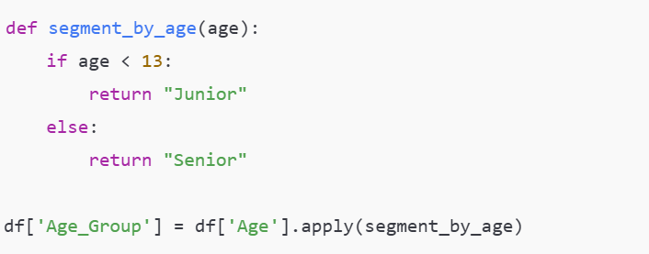
Segmentation – III
Let’s say we want to segment students as:
‘Juniors’ if age is 12.
‘Senior’ if age is 13 or above

Slide 15
Segmentation – IV
In a same manner, we can understand the ‘segmentation’ part of the code that we did in Google Colab.

Slide 16
The End.
Thank You!

